Slide 1
Numerical simulation of randomly generated states for a 2-qubit system and classification according to Concurrence, PPT criterion and Negativity
Department of physics, Faculty of science, Ferdowsi university of Mashhad
By Fateme Dashti
Under the Guidance of Dr. S. J. Akhtarshenas
September 2024

Slide 2
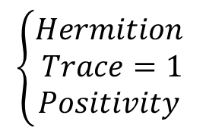



“ State Space
$$\left\{\begin{aligned}Hermition \\ Trace=1 \\ Positivity \end{aligned}\right.$$
Ѕ(ℌ) :
Real coefficients
$$ρ=\frac{1}{2}\left(\text{𝕝}+\vec{r}.\vec{σ}\right)$$
$\vec{r} :$ Bloch vector
$\vec{σ}$: Pauli matrices
$\sqrt{x^{2}{+y}^{2}+z^{2}}$ $≤1$
Bloch sphere

Slide 3
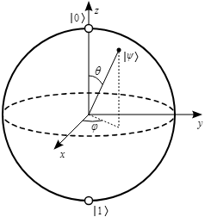
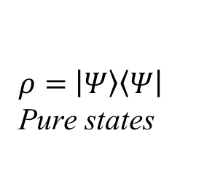
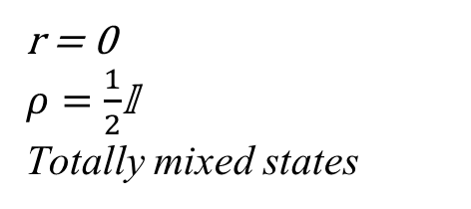
“ Bloch sphere
r = 0 $ρ=\frac{1}{2}$𝕝
Totally mixed states
$ρ=$ $\left|\left.Ψ\right\rangle \left\langle Ψ\right.\right|$
Pure states

Slide 4
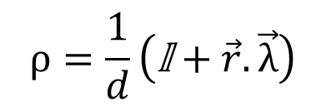
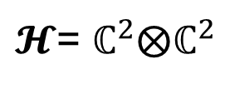
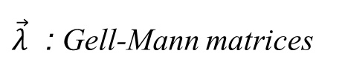
“ Hilbert-Schmidt
$$ρ=\frac{1}{d}\left(\text{𝕝}+\vec{r}.\vec{λ}\right)$$
Qudit !
$\vec{λ}$ : Gell-Mann matrices
For two-qubit system :
$𝓗$= $ℂ^{2}$⨂$ℂ^{2}$
$$ρ=\frac{1}{4}\left(\text{𝕝}⊗𝕝+\left(\vec{r}.\vec{σ}\right)⊗𝕝+𝕝⊗\left(\vec{s}.\vec{σ}\right)+t_{ij}({\vec{σ}}_{i}⊗{\vec{σ}}_{j})\right)$$

Slide 5




“ Hilbert-Schmidt
$$ρ=\frac{1}{4}\left(\text{𝕝}⊗𝕝+\left(\vec{r}.\vec{σ}\right)⊗𝕝+𝕝⊗\left(\vec{s}.\vec{σ}\right)+t_{ij}({\vec{σ}}_{i}⊗{\vec{σ}}_{j})\right)$$
$$Tr\left(σ_{i}σ_{j}\right)=2δ_{ij}$$
$$r_{i}=Tr[ρ\left({\vec{σ}}_{i}⊗𝕝\right)]$$
$$t_{ij}=Tr[ρ\left({{\vec{σ}}_{i}⊗\vec{σ}}_{j}\right)]$$
$$s_{j}=Tr[ρ\left({𝕝⊗\vec{σ}}_{j}\right)]$$

Slide 6
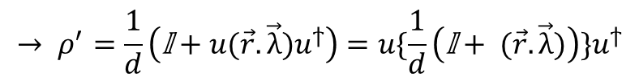
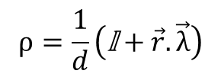
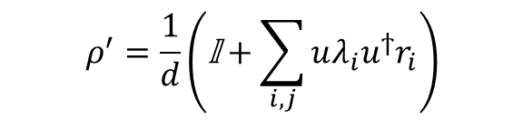
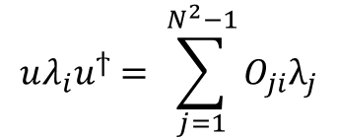

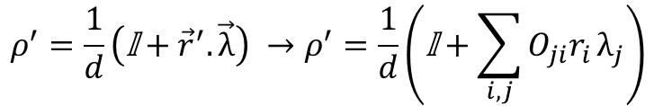



“ But How did we generate the random states
$$r_{j}^{′}=O_{ji}r_{i}$$
$$ρ=\frac{1}{d}\left(\text{𝕝}+\vec{r}.\vec{λ}\right)$$
$$SO(3)↔SU(2)$$
$$\vec{r}$$
$$ρ^{′}=\frac{1}{d}\left(\text{𝕝}+{\vec{r}}^{′}.\vec{λ}\right) →ρ^{′}=\frac{1}{d}\left(\text{𝕝}+\sum_{i,j}{O_{ji}r_{i}}λ_{j}\right)$$
$$uλ_{i}u^{ϯ}= \sum_{j=1}^{N^{2}−1}{O_{ji}λ_{j}}$$
$$ρ^{′}=\frac{1}{d}\left(\text{𝕝}+\sum_{i,j}{uλ_{i}u^{ϯ}r_{i}}\right)$$
$$→ ρ^{′}=\frac{1}{d}\left(\text{𝕝}+u(\vec{r}.\vec{λ})u^{ϯ}\right)=u\{\frac{1}{d}\left(\text{𝕝}+ (\vec{r}.\vec{λ})\right){\}u}^{ϯ}$$
$$ρ→ρ^{′}=uρu^{ϯ}$$

Slide 7
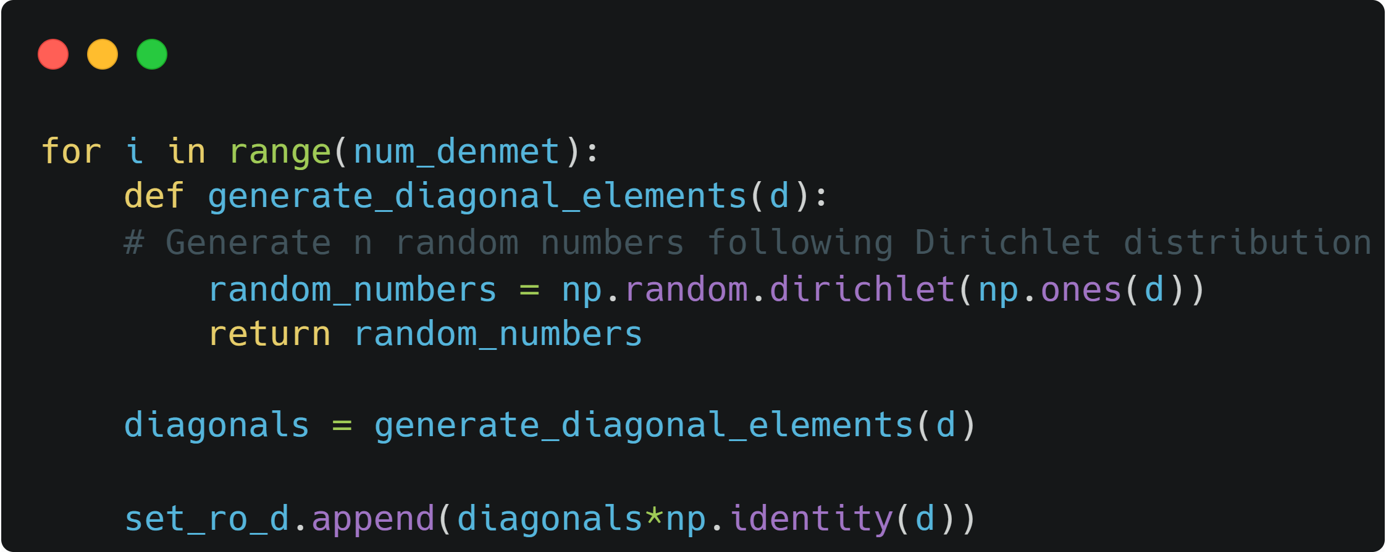

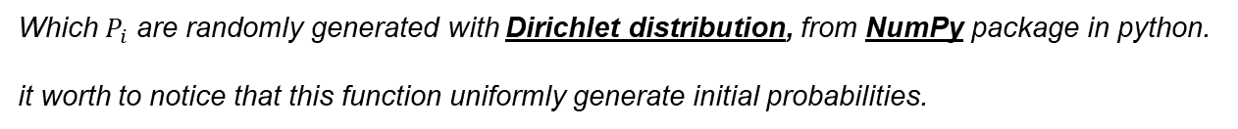
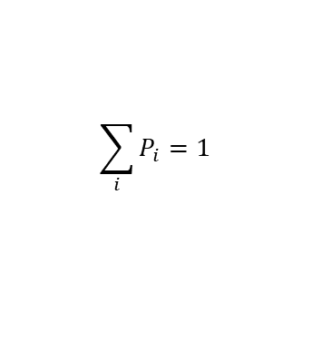
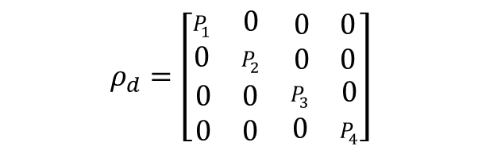
“ How did we generate the random uniform probabilities
$$ρ^{′}=uρ_{d}u^{ϯ}$$
$$ρ_{d}=\left[\begin{matrix}\begin{matrix}P_{1} & 0 \\ 0 & P_{2}\end{matrix} & \begin{matrix}0 & 0 \\ 0 & 0\end{matrix} \\ \begin{matrix}0 & 0 \\ 0 & 0\end{matrix} & \begin{matrix}P_{3} & 0 \\ 0 & P_{4}\end{matrix}\end{matrix}\right]$$
$$\sum_{i}{P_{i}}=1$$
Which $P_{i}$ are randomly generated with Dirichlet distribution, from NumPy package in python. it worth to notice that this function uniformly generate initial probabilities.

Slide 8
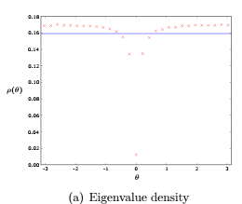

“ How did we generate random Unitary matrix
$$ρ^{′}=uρu^{ϯ}$$
“steps
Uniform , random unitary matrix
First we generate a random complex matrix
We use QR decomposition to decompose our random complex matrix to one unitary matrix (Q) and one upper-triangular (R)
But the output is not distributed with Haar measure.
in the case of unitary matrices distributed according to the Haar measure:
(large matrices) random matrix theory
eigenvalues tend to repel each other (level repulsion)
average density of eigenvalues around the unit circle is approximately constant
Francesco Mezzadri 2007

Slide 9


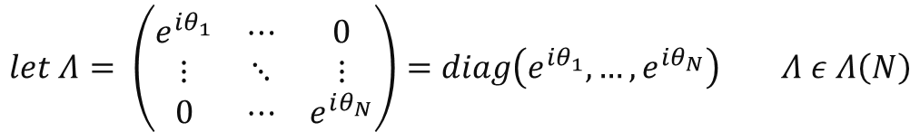

“ Our problem with random unitary matrix distribution
The main problem is that QR decomposition is not unique !
$Zε GL\left(N,ℂ\right) , Z=QR which Q is unitary and R is upper triangular matrices.$
$$let Λ= \left(\begin{matrix}e^{iθ_{1}} & ⋯ & 0 \\ ⋮ & ⋱ & ⋮ \\ 0 & ⋯ & e^{iθ_{N}}\end{matrix}\right)=diag\left(e^{iθ_{1}},…,e^{iθ_{N}}\right) Λ ε Λ\left(N\right)$$
$"unitary diagonal matrices group "$
$Q^{′}=QΛ and R^{′}=Λ^{−1}R are still unitary and upper riangular respectively.$
$$QR decomposition defines a multi valued map:$$
$$Z=QR=Q^{′}R^{′}$$
$$QR:GL\left(N,ℂ\right) →U(N)×T(N)$$
Francesco Mezzadri 2007

Slide 10

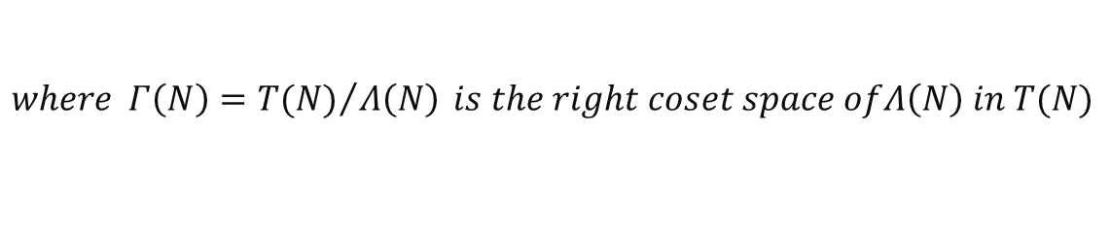


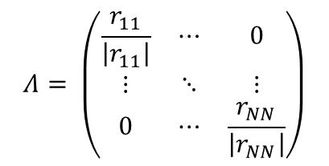


“ Our problem with random unitary matrix distribution
$$QR:GL\left(N,ℂ\right) →U(N)×T(N)$$
$$QR=Q^{′}R^{′}$$
$$Λ\left(N\right)=U\left(N\right)∩T\left(N\right)$$
𝑠𝑜 𝑤𝑒 𝑠ℎ𝑜𝑢𝑙𝑑 𝑐𝑜𝑛𝑠𝑖𝑑𝑒𝑟 𝑜𝑛𝑒−𝑡𝑜−𝑜𝑛𝑒 𝑚𝑎𝑝:
$$\overline{QR}:GL\left(N,ℂ\right) →U(N)×Γ(N)$$
$$where Γ\left(N\right)={T(N)}/{Λ\left(N\right) }is the right coset space ofΛ\left(N\right) in T(N)$$
can be chosen by fixing the arguments of the elements of the main diagonal of $R ϵ T(N)$
$$Λ= \left(\begin{matrix}\frac{r_{11}}{\left|r_{11}\right|} & ⋯ & 0 \\ ⋮ & ⋱ & ⋮ \\ 0 & ⋯ & \frac{r_{NN}}{\left|r_{NN}\right|}\end{matrix}\right)$$
$$r_{jj}$$
Francesco Mezzadri 2007

Slide 11
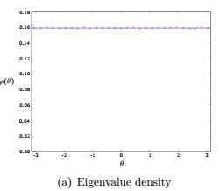
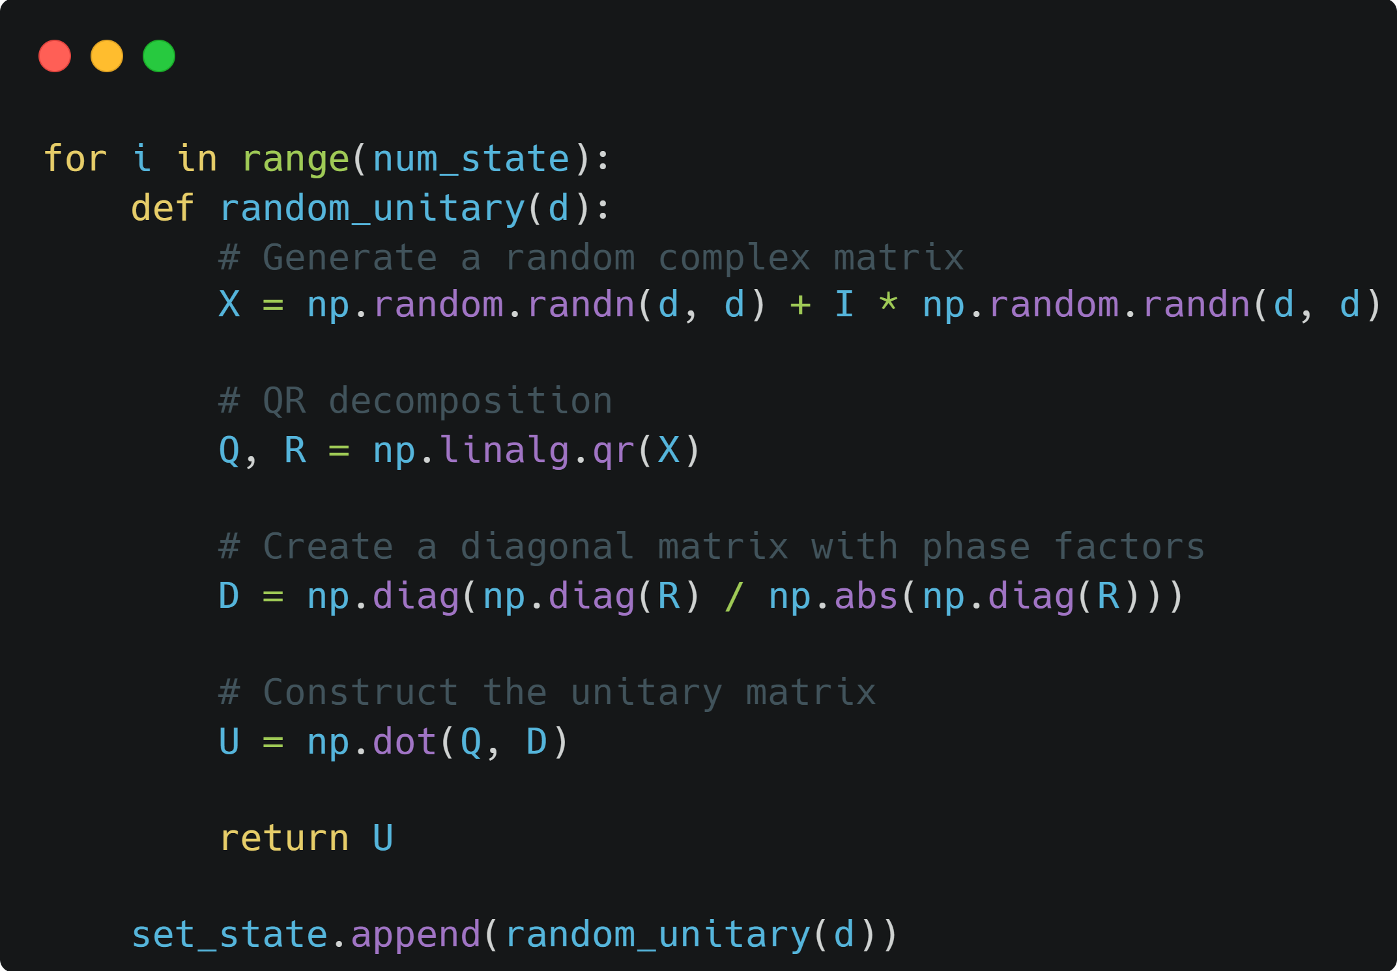

“ How did we generate random Unitary matrix
$$ρ^{′}=uρu^{ϯ}$$
$$The Q^{′}=QΛ is distributed with Haar measure$$
Francesco Mezzadri 2007

Slide 12
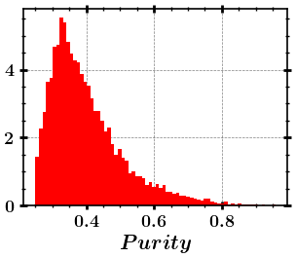
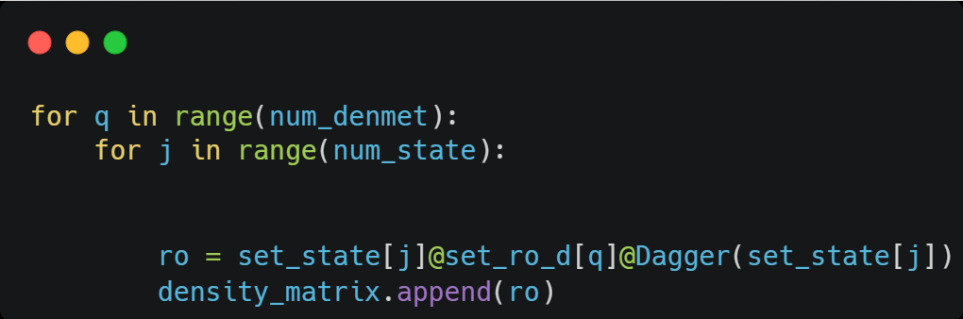
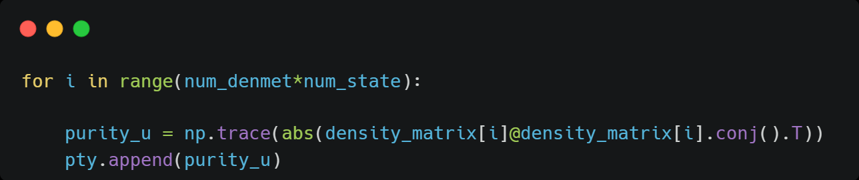
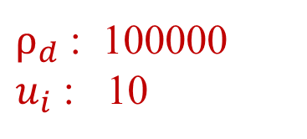

“ Purity of randomly generated states
$ρ_{d}$ : 100000
$u_{i}$ : 10
$$ρ^{′}=uρu^{ϯ}$$

Slide 13
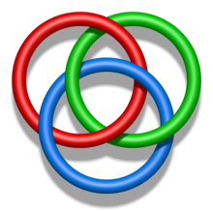
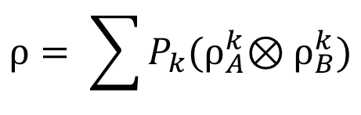
“ Separability and Entanglement
$$ρ= \sum{P_{k}{(ρ}_{A}^{k}⊗ρ_{B}^{k})}$$
If it can’t be written as convex sum of pure states, $ρ$ is Entangled !

Slide 14
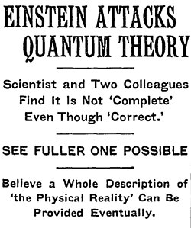
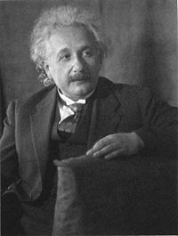
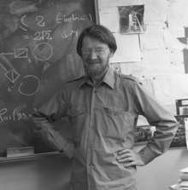
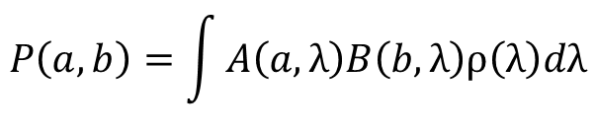

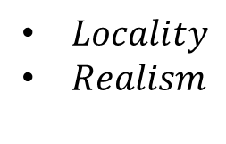
“ EPR: local hidden variable model theory
Bell inequality
$$P\left(a,b\right)=\int{A\left(a,λ\right)B\left(b,λ\right)ρ\left(λ\right)dλ}$$
$Locality$
$Realism$
$$\left\langle B\right\rangle ≤β_{LR}$$

Slide 15
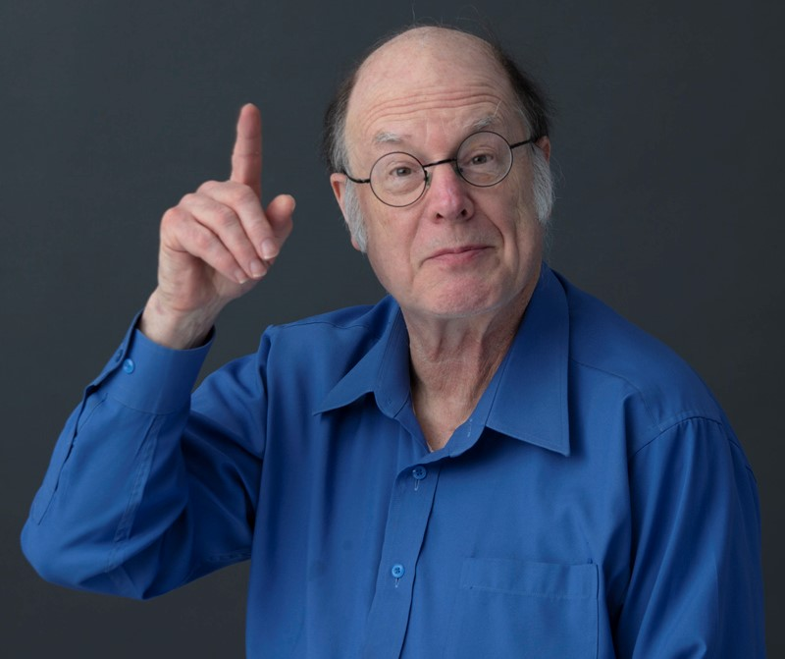

Entanglement Of Formation and Concurrence
01
This theorem was discovered in 1996 and 1998 by Charles H. Bennett , John A. Smolin and William K. Wootters.

Slide 16
‘’Intro: a pure bipartite quantum state using schmidt decomposition’’
Entanglement Of Formation(EOF)
Density matrix
of it

Slide 17
‘’Intro: a pure bipartite quantum state using schmidt decomposition’’
Entanglement Of Formation(EOF)
the reduced density matrices
of system A
the reduced density matrices
of system B
The von Neumann entropy
of the reduced density matrix
Von Neumann, John (1955). Mathematical Foundations of Quantum Mechanics. Princeton University Press.

Slide 18
‘’Intro: a pure bipartite quantum state using schmidt decomposition’’
Entanglement Of Formation(EOF)
The von Neumann entropy
of the reduced density matrix
This can be used to measure the entanglement of the state ᴪ !!!
This is also known as entanglement entropy or the entanglement of formation(EOF) of a pure state.

Slide 19
‘’for a Mixed quantum state’’
Entanglement Of Formation(EOF)
Mixed state :
Entanglement Of Formation:
It shows only a part of entanglement !
Because

Slide 20
‘’for a Mixed quantum state’’
Entanglement Of Formation(EOF)
Mixed state :
Entanglement Of Formation:
It shows only a part of entanglement !
Because

Slide 21
‘’for a Mixed quantum state’’
Entanglement Of Formation(EOF)
We define the entanglement of formation for mixed states by minimizing over all these ensemble realizations:
C. H. Bennett, D. P. DiVincenzo, J. A. Smolin, and W. K. Wootters, Phys. Rev. A54, 3824 (1996).

Slide 22
‘’ For two-qubit systems’’
Entanglement Of Formation(EOF)
W. K. Wootters, Phys. Rev. Lett. 80, 2245 (1998).

Slide 23
‘’ For two-qubit systems’’
Entanglement Of Formation(EOF)
When
Therefore Concurrence is as good as EOF!

Slide 24
‘’ For two-qubit systems’’
Entanglement Of Formation(EOF)
???

Slide 25
‘’ For two-qubit systems’’
Entanglement Of Formation(EOF)
What are these Lambdas?
They are the eigenvalues of the matrix :
in nondecreasing order

Slide 26
‘’ For two-qubit systems’’
Entanglement Of Formation(EOF)
WHAT WE DID:
STEPS
Eigenvalues:
A positive num

Slide 27
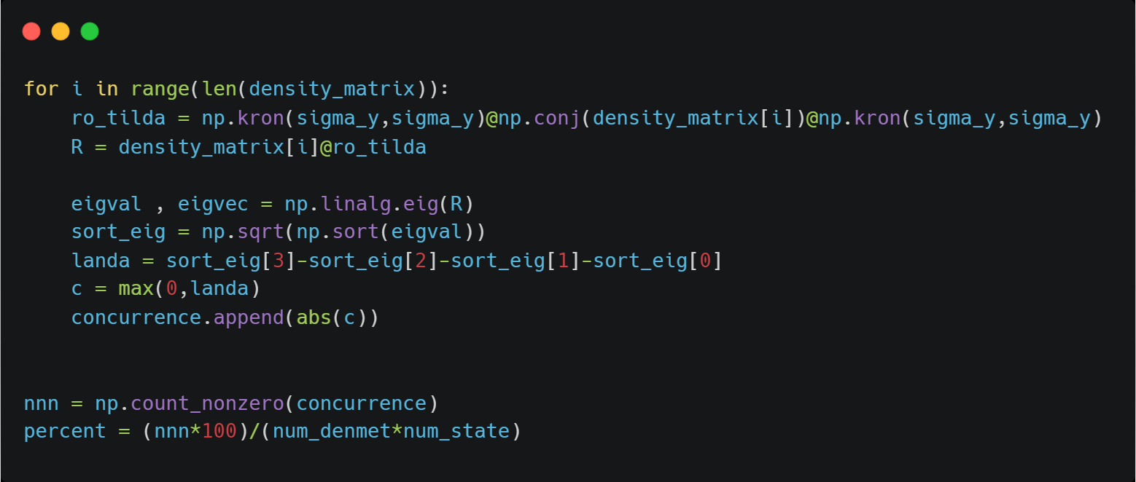
“ The main loop for checking concurrence

Slide 28
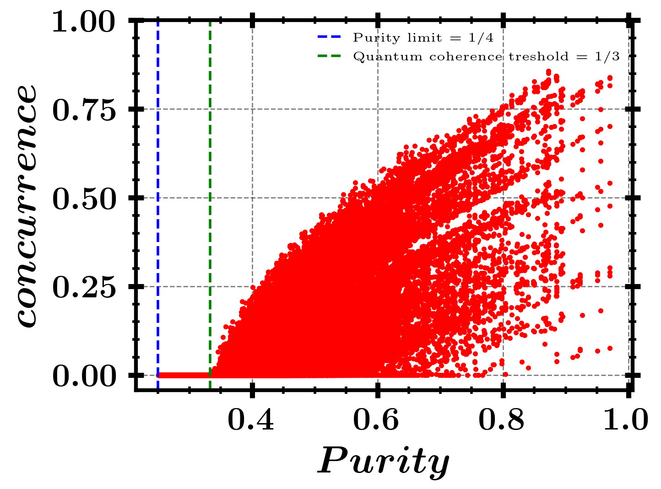
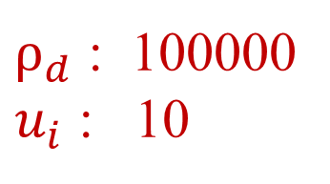
“ Result
$ρ_{d}$ : 100000
$u_{i}$ : 10
37.069% of the randomly generated states are Entangled state as far as concurrence can tell !
For a sample run:

Slide 29
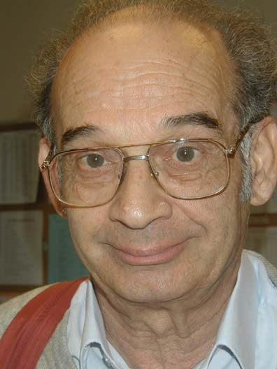
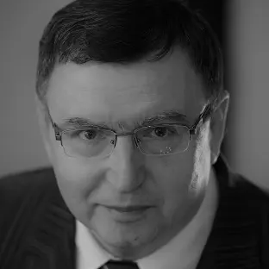
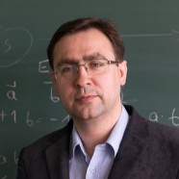
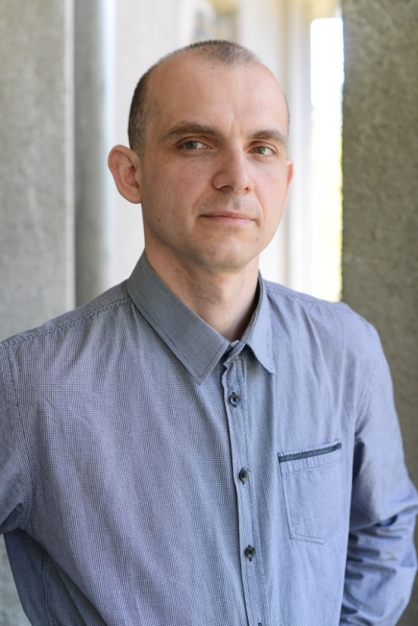
Peres-Horodecki Criterion (PPT)
02
This theorem was discovered in 1996 by Asher Peres and the Horodecki family (Michał, Paweł, and Ryszard).

Slide 30
Peres-Horodecki criterion (PPT)
“Intro: partial transpose”
Alice:
Bob:
A composite system:
Separable state
ROW
COLUMN

Slide 31
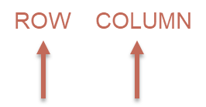
Peres-Horodecki criterion (PPT)

Slide 32
Peres-Horodecki criterion (PPT)
Transpose:

Slide 33
Peres-Horodecki criterion (PPT)
Partial transpose :
(respect to Alice)

Slide 34
Peres-Horodecki criterion (PPT)
Partial transpose :
(respect to Bob)

Slide 35
Peres-Horodecki criterion (PPT)
“Intro: partial transpose”
Partial transpose :
(respect to Alice)
Partial transpose :
(respect to Bob)
Transpose :

Slide 36
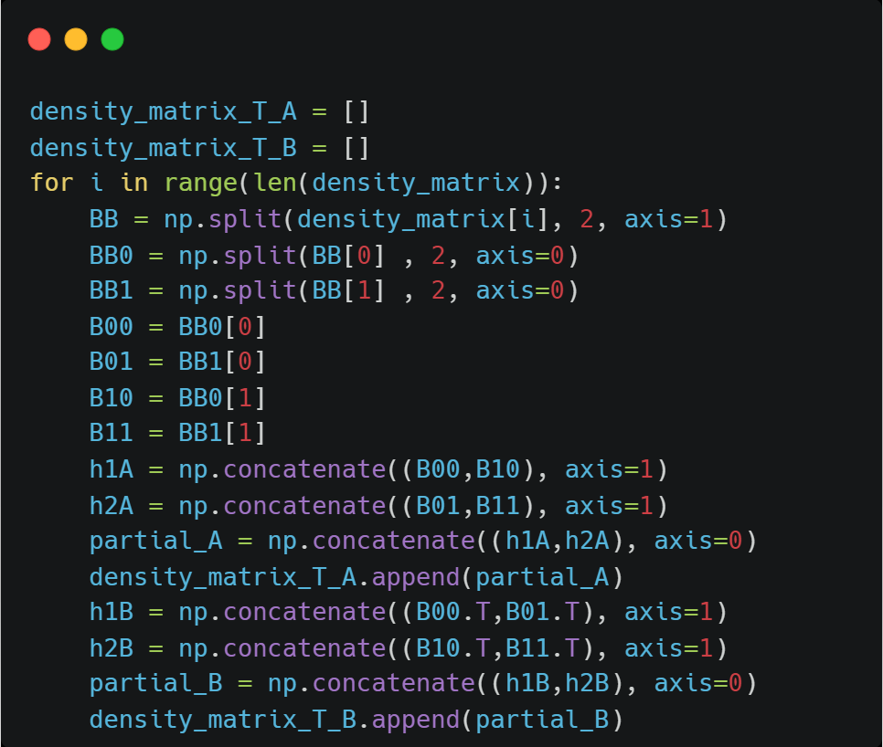
“ calculating the partial trace

Slide 37
Peres-Horodecki criterion (PPT)
“Peres criterion”
This criterion is necessary condition, for the joint density matrix ρ of two quantum mechanical systems A and B to be separable.
But not sufficient !!

Slide 38
Peres-Horodecki criterion (PPT)
“Peres criterion”
Proof :

Slide 39
Peres-Horodecki criterion (PPT)
“Peres-Horodecki criterion: positive partial transpose”
This criterion is necessary condition, for the joint density matrix ρ of two quantum mechanical systems A and B to be separable.
In the 2×2 and 2×3 dimensional cases the condition is also sufficient.
Peres, Asher (August 19, 1996). "Separability Criterion for Density Matrices". Physical Review Letters. 77 (8): 1413–1415. arXiv:quant-ph/9604005
Horodecki, Michał; Horodecki, Paweł; Horodecki, Ryszard (1996). "Separability of mixed states: necessary and sufficient conditions". Physics Letters A. 223 (1–2): 1–8. arXiv:quant-ph/9605038

Slide 40
Example: werner state
Partial transpose :
eigen values:
It can be also negative!!!
In this case we can determine the entangled part.

Slide 41


Example: werner state
$\frac{1}{3}$≤P≤1→ Based on PPT criterion: entangled !!!
0
$$\frac{1}{3}$$
0.7
0.74
1
$0.7$≤P≤1→ Based on Bell inequality : entangled !!!
$0.74$≤P≤1→ Based on entropy measure : entangled !!!

Slide 42
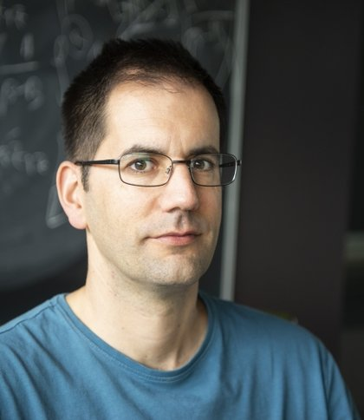
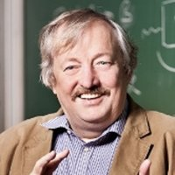
Negativity
03
The concept of the negativity of a state is closely related to the well-known Peres-Horodecki condition.
It was proved by Vidal and Werner that negativity is an entanglement monotone; hence, is a good entanglement measure.

Slide 43
Negativity
From PPT criterion :
It turns out that the partial transpose of a non-separable state has one or more negative eigenvalues.
We will adopt the deﬁnition of negativity as
the sum of the negative eigenvalues of
In two-qubit systems:
the partial transpose of the density matrix, can have at most one negative eigenvalue.
for two-qubit pure states:
the negativity gives the same value as the concurrence does.
G. Vidal and R. F. Werner, Phys. Rev. A 65, 032314 (2002).
T. C. Wei, K. Nemoto, P. M. Goldbart, P. G. Kwiat, W. J. Munro, F. Verstraete, Maximal entanglement versus entropy for mixed quantum states

Slide 44
Negativity
WHAT WE DID:
STEPS
eigenvalues of
Sum the negative ones

Slide 45
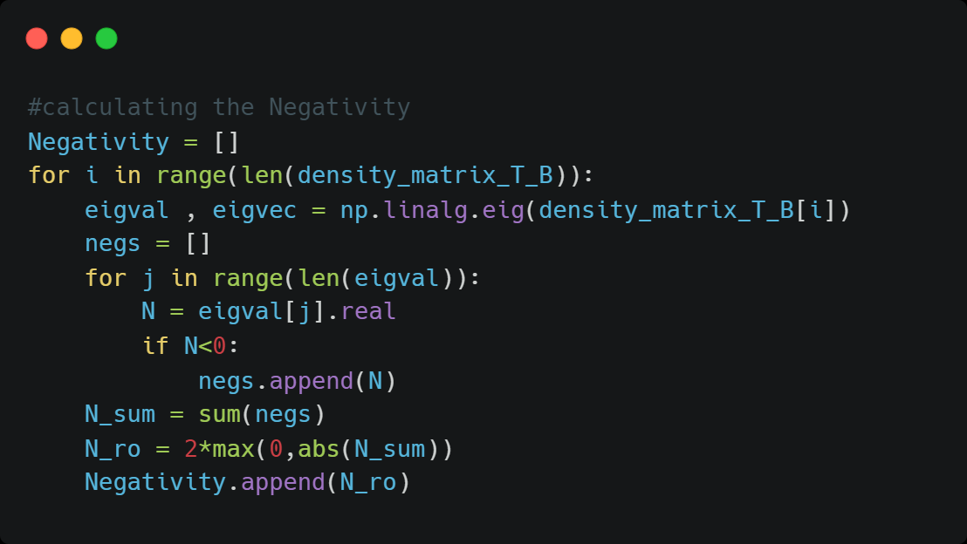
‘’Calculating the Negativity

Slide 46
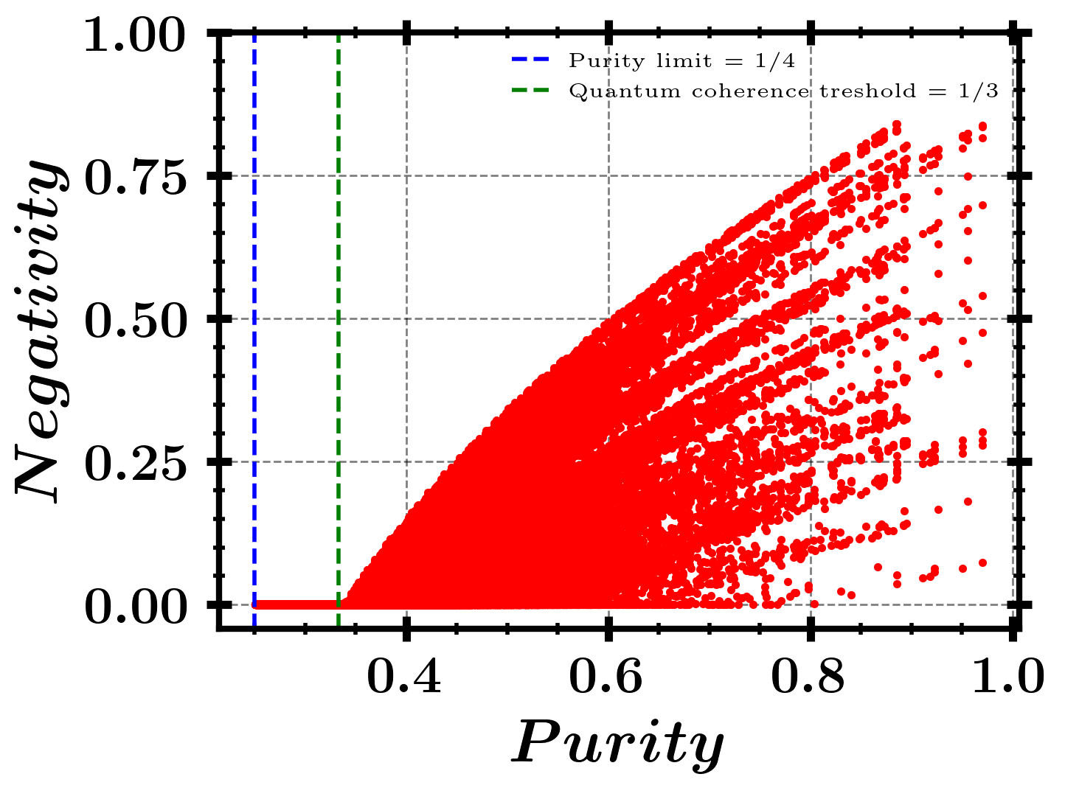
“ Result
$ρ_{d}$ : 100000
$u_{i}$ : 10
37.069% of the randomly generated states are Entangled state as far as Negativity can tell !
For a sample run:

Slide 47
“ comparison
Concurrence is more sensitive to the purity of state!
MEMs: Maximum Entanglement Measures

Slide 48
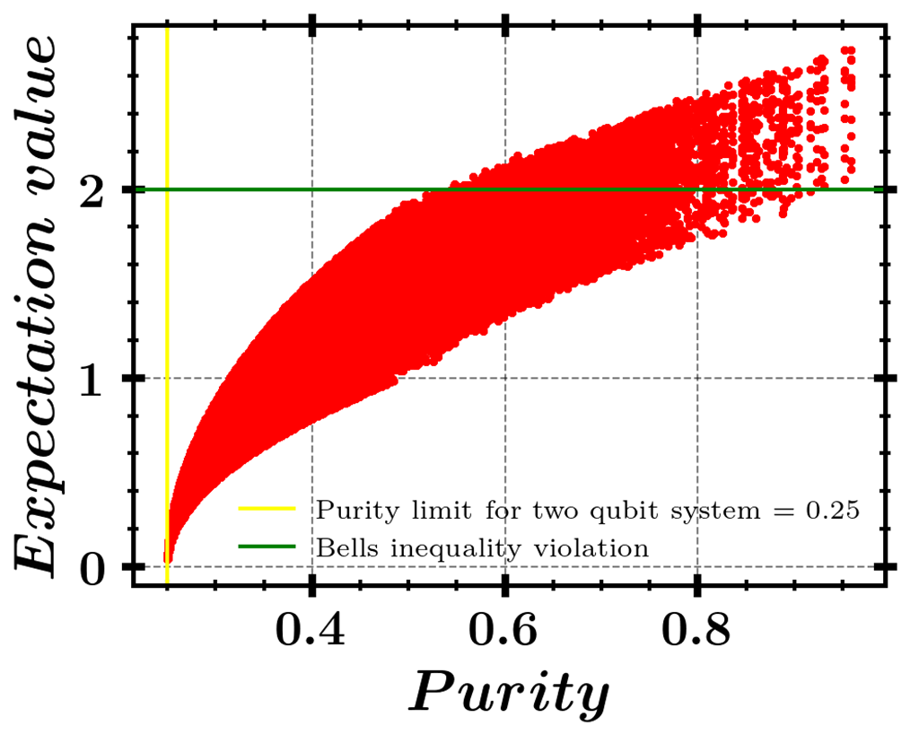
As we saw in previous presentation we investigate different entanglement measures.
different entanglement measures can give different orderings for pairs of mixed states.
Now we investigate the highest possible entanglement for a given level of mixedness
“MEMS”
G. Vidal and R. F. Werner, Phys. Rev. Lett. 2002
K. Zyczkowski, P. Horodecki, A. Sanpera, and M. Lewen-stein, Phys. Rev. Lett. 1998
A. Peres, Phys. Rev. Lett. 77, 1413 (1996); M. Horodecki, P. Horodecki, and R. Horodecki, Phys. Lett.

Slide 49


“ Concurrence vs Negativity
Maximum negativity for a given value of concurrence using Lagrange optimization techniques.
F. Verstraete, K. Audenaert, J. Dehaene, B. De Moor, J. Phys. A 34, 10327 (2001).
Tzu-Chieh Wei (1), Kae Nemoto (2), Paul M. Goldbart (1), Paul G. Kwiat (1), William J. Munro (3), Frank Verstraete (4) Maximal entanglement versus entropy for mixed quantum states

Slide 50








“ Negativity vs Linear Entropy
$$S_{L}\left(ρ\right)=\frac{N}{N−1}[1−Tr\left(ρ^{2}\right)]$$
$$N\left(ρ\right)=\frac{{\left\|ρ^{T_{B}}\right\|}_{1}−1}{2}$$
$$ℒ=N\left(ρ\right)+λ(S_{L}\left(ρ\right)−S_{0})$$
Example (Werner states):
$$ρ_{W}\left(P\right)=P\left|\left.Ψ^{−}\right\rangle \left\langle Ψ^{−}\right.\right|+(1−p)\frac{I}{4}$$
$$S_{L}\left(ρ_{W}\left(P\right)\right)=\frac{3P^{2}}{2}$$
$$N\left(ρ\right)= Max(0,\frac{P}{2})$$
Maximal entanglement versus entropy for mixed quantum states
Tzu-Chieh Wei (1), Kae Nemoto (2), Paul M. Goldbart (1), Paul G. Kwiat (1), William J. Munro (3), Frank Verstraete (4)

Slide 51






“ Von Neumann Entropy vs Linear Entropy
$$S_{L}\left(ρ\right)=\frac{N}{N−1}[1−Tr\left(ρ^{2}\right)]$$
$$S_{VN}\left(ρ\right)=−Tr(ρLog(ρ))$$
$ℒ=$ $−Tr(ρLog(ρ))$+𝜆($1−Tr\left(ρ^{2}\right)$- $S_{L}$)
Maximize von Neumann entropy for a fixed linear entropy using Lagrange multipliers
$$ℒ=−\sum_{i}{λ_{i}Log\left(λ_{i}\right)+λ(1−\sum_{i}{{λ_{i}}^{2}}−S_{0})}$$
Maximal entanglement versus entropy for mixed quantum states
Tzu-Chieh Wei (1), Kae Nemoto (2), Paul M. Goldbart (1), Paul G. Kwiat (1), William J. Munro (3), Frank Verstraete (4)

Slide 52
Thank you for your time and attention!
Feel free to ask any questions!
Special thanks to S.J. Akhtarshenas for their invaluable support and guidance throughout this project.
And also to A. T. Jamshidi for their hard work, collaboration, and dedication.

